Slide 1
Boolean and Vector Space Retrieval Models
000 Dik Lun LEE Department of Computer Science, HKUST Slide <number>

Slide 2
Retrieval Models
A retrieval model specifies the details of
  document representation
  query representation
  retrieval function
Three main classes of retrieval models
  Boolean model
  (statistical) vector space model
  probabilistic model
Distinction between model and implementation:
  A model can be implemented in many ways; the inverted file (or b-tree) is just an implementation method, not a retrieval model
000 Dik Lun LEE Department of Computer Science, HKUST Slide <number>

Slide 3
Boolean Model
Or called “bag of words” or “bow”
A document is represented as a set of keywords
  The keywords may be preprocessed by stopword removal and stemming
Queries are expressed as a Boolean expression of keywords, connected by AND, OR, and NOT, including brackets
  E.g., DBMS AND Oracle AND NOT Sybase
  How do you specify Boolean operators in Google or Yahoo!?
A document is retrieval based on whether or not its keywords satisfy the Boolean query
000 Dik Lun LEE Department of Computer Science, HKUST Slide <number>

Slide 4
Boolean Models − Strengths
By far the most popular retrieval model because
  easy to understand for simple queries
  good control of the result set by using complex Boolean expressions
Rather efficient implementations (using inverted file; later lectures)
  as far as identifying documents containing a term is concerned
  need other supporting structure, e.g., forward index for deletion
Users with some training can formulate simple Boolean queries easily
Boolean models can be extended to include ranking
000 Dik Lun LEE Department of Computer Science, HKUST Slide <number>

Slide 5
Boolean Models − Problems
Very rigid: AND means all; OR means either one
  what about “I want m of these n words”?
Difficult to express complex user requests
  Boolean expressions with two or more levels of brackets are practically incomprehensible to typical users
The meaning of AND and OR may be interpreted differently
  In a restaurant menu, you may see “Breakfast includes two eggs, fried or scrambled; toast or biscuit, and Coffee or juice”
  Common sense: either fried or scrambled; math sense: could be both
  “I bought some books on computer and economics”, which could mean you have books about computers and books about economics
Enhancements could be incorporated, e.g., for “A or B”, rank results containing both A and B first, then results containing either A or B.
For “m out of n words”, get results containing all n words first then those containing n-1 words next, etc.
000 Dik Lun LEE Department of Computer Science, HKUST Slide <number>

Slide 6
Boolean Models − Problems (Cont.)
Difficult to control the number of documents retrieved
  all matched documents in principle will be returned
  To get fewer results: add conjunctive terms to or remove disjunctive terms (if any) from the query
  To get more: remove conjunctive terms from or add disjunctive terms to the query
Difficult to rank output
  all matched documents satisfy the query in the same way
  Can only rank by date, alphabetical order, etc.
Difficult to perform automatic relevance feedback
  if a document is identified by the user as relevant, how do I incorporate new terms into the query? AND? OR?
000 Dik Lun LEE Department of Computer Science, HKUST Slide <number>

Slide 7
A Case Study
Evaluation by Blair and Maron [CACM, March 1985]
  40,000 legal documents.
  System: STAIRS with ranking by number of matches found in documents. (STAIR was a popular document management system from IBM in the 70’s)
  Original queries were given by lawyers.
  Boolean queries were formulated by paralegals with expertise in STAIRS
  Interaction between lawyers and paralegals were allowed to come up with the “best” query formulations in Boolean
  Iterations continued until the lawyers were satisfied with the result
  Average Precision and Recall = 20% and 80%, respectively (i.e., 20% of the returned results are relevant, and 80% of all relevant results is returned)
Why?
How to interpret these numbers? Good or bad?
000 Dik Lun LEE Department of Computer Science, HKUST Slide <number>

Slide 8
Precision versus Recall
Informally:
Precision => How many of the results I see are relevant to my query?
Recall => Have I seen all of the relevant results? How many useful results am I missing?
Want high precision:
Want high recall:
000 Dik Lun LEE Department of Computer Science, HKUST Slide <number>

Slide 9
Statistical Models
Keyword based (a document is represented by a list of keywords) plus statistical information about the keywords
  D1= ⟨ text 1.0; retrieval 1.0; database 0.5; computer 0.8; information 0.2 ⟩
User specifies a set of desired terms with optional weights
  Weighted query terms : Q = ⟨ database 0.5; text 0.8; information 0.2 ⟩
  Unweighted query terms : Q = ⟨ database; text; information ⟩
  No Boolean conditions specified in the query
Retrieval based on similarity between query and documents
  Similarity is based on the statistical properties of the documents (which is often based on the occurrence frequencies of keywords in the documents)
Outputs are ranked according to similarity
000 Dik Lun LEE Department of Computer Science, HKUST Slide <number>

Slide 10
Advantage of Uniform Query/Document Vectors
Automatic relevance feedback can be supported
  Useful terms are just “added” to the original query
  e.g., Q ⇒ ⟨ database, text, information, document ⟩
Q = ⟨ database, text, information ⟩
Search
engine
Q’ = ⟨ database, text, retrieval, architecture ⟩
D_{i} = ⟨ retrieval 1.0, database 0.5, architecture 1.2, computer 0.0, text 0.8, management 0.9, information 0.0 ⟩
Compare to Boolean model
  Suppose query is: database AND text AND information
How can you improve the query based on Di?
  Database AND text AND (information OR architecture OR retrieval)?
  (Database AND architecture) OR (text AND retrieval)?
000 Dik Lun LEE Department of Computer Science, HKUST Slide <number>

Slide 11
Problems to Solve in Statistical Models
How to determine important words in a document?
How to determine the degree of importance of a word within a document and within the entire collection?
How to determine the degree of similarity between a document and the query?
In the case of WWW, what is a collection and what are the effects of links, document structures, and other format information (bold, etc)?
000 Dik Lun LEE Department of Computer Science, HKUST Slide <number>

Slide 12
How to determine important words
in a document?
Intra-document importance of a word: Local weight
Inter-document importance of a word: Global weight
000 Dik Lun LEE Department of Computer Science, HKUST Slide <number>

Slide 13
Document and Term Weights
Document term weights are calculated using frequencies in documents (tf) and in collection (idf)
tf_{ij} = frequency of term j in document i
df_{j} = document frequency of term j
= number of documents containing term j
idf_{j} = inverse document frequency of term j
= log₂ (N/ df _{j}) (N: number of documents in collection)
Inverse document frequency -- an indication of a term’s ability as a document discriminator.
df_{j} / N probability that a random document contains term j
000 Dik Lun LEE Department of Computer Science, HKUST Slide <number>
Notes:
df_{j}/N is the probability that a randomly selected documents contains term j.

Slide 14
Term Weight
A typical combined term importance indicator
w_{ij} = tf_{ij}• idf_{j} = tf_{ij}• log₂ (N/ df _{j})
A term occurs frequently in the document but rarely in the remaining of the collection has a high weight
tf_{ij}• idf_{j} gives a weight that is directly proportional to the number of occurrences of a term in a document
Another example using normalized term frequency:
w_{ij} = (tf_{ij} /max_{l}{tf_{lj}}) • idf_{j} = (tf_{ij} /max_{l} {tf_{lj}}) • log₂ (N/ df _{j})
  max_{l}{tf_{lj}} is the term frequency of the most frequent term in document j
There are many other ways of determining term weights
000 Dik Lun LEE Department of Computer Science, HKUST Slide <number>

Slide 15
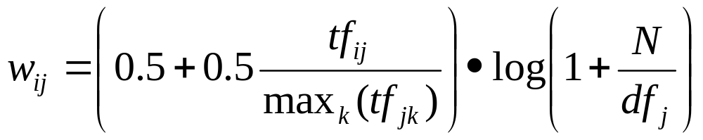
Improved Term Weights
The “modified tf” term ranges from near 0.5 to 1
The “modified idf” term ranges from log(2) to log(N+1)
  I.e., a term appearing in all documents still has a non-zero weight
000 Dik Lun LEE Department of Computer Science, HKUST Slide <number>

Slide 16
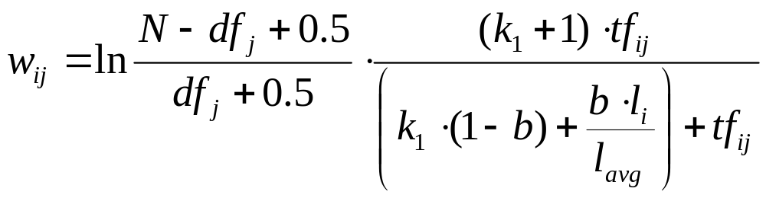
Improved Term Weights (BM25)
Known as BM25, implemented in an experimental system called OKAPI
  k₁ and b typically set to 2.0 and 0.75, respectively
  l_{i} : length of document i
  l_{avg} : average document length in the collection
Document length affects term weighting
  If term weights are pre-computed: Very expensive to update
  OK if term weights are computed dynamically
000 Dik Lun LEE Department of Computer Science, HKUST Slide <number>

Slide 17
How to determine the degree of similarity between a document and the query?
000 Dik Lun LEE Department of Computer Science, HKUST Slide <number>

Slide 18

The Vector-Space Model
T distinct terms are available; call them index terms or the vocabulary
The index terms represent important terms for an application
  What might be the index terms for a computer science library?
architecture
bus
computer
database
….
xml
computer science
collection
index terms or vocabulary or vector space
of the collection
For now: we only consider single terms (no phrases)
000 Dik Lun LEE Department of Computer Science, HKUST Slide <number>

Slide 19
Representing a Vector Space
Previously, we say a document can be represented by a list of keywords:
  D1 = ⟨ text 1.0; retrieval 1.0; database 0.5; computer 0.8; information 0.2 ⟩
  or
  D2 = ⟨ database 1.0; architecture 0.8; retrieval 0.8; management 0.2 ⟩
A collection of N documents can be represented as a document-term matrix
  A document is a term vector
  An entry in the matrix corresponds to the “weight” of a term in the document; zero means the term has no significance or simply doesn't exist in the document
T₁ T₂ …. T_{t}
D₁ d₁₁ d₁₂ … d_{1t}
D₂ d₂₁ d₂₂ … d_{2t}
: : : :
: : : :
D_{n} d_{n1} d_{n2} … d_{nt}
architecture
management
retrieval
computer
information
database
text
D1 = 1.0 0.5 0.0 0.8 1.0 0.0 0.2
D2 = 0.8 1.0 0.8 0.0 0.0 0.2 0.0
000 Dik Lun LEE Department of Computer Science, HKUST Slide <number>

Slide 20
The Vector-Space Model
A vocabulary of 2 terms forms a 2D space; a document may contain 0, 1 or 2 terms
t₁ t₂
  d_{i} = ⟨ 0, 0 ⟩ (contains none of the index terms)
  d_{j} = ⟨ 0, 0.7 ⟩ (contains one of the two index terms)
  d_{k} = ⟨ 1, 2 ⟩ (contains both index terms)
Likewise, a vocabulary of 3 terms forms a 3D space
A vocabulary of n terms forms a n-dimensional space
A document or query can be represented as a linear combination of T’s
t₂
d_{k}
d_{j}
d_{i}
t₁
000 Dik Lun LEE Department of Computer Science, HKUST Slide <number>

Slide 21
Graphic Representation
Example:
D₁ = 2T₁ + 3T₂ + 5T₃
D₂ = 3T₁ + 7T₂ + T₃
Q = 0T₁ + 0T₂ + 2T₃
T₃
5
D₁ = 2T₁+ 3T₂ + 5T₃
Q = 0T₁ + 0T₂ + 2T₃
2
3
T₁
D₂ = 3T₁ + 7T₂ + T₃
3
Is D₁ or D₂ more similar to Q?
How to measure the degree of similarity? Distance? Angle? Projection?
7
T₂
000 Dik Lun LEE Department of Computer Science, HKUST Slide <number>

Slide 22
Similarity Measure
A similarity measure is a function which computes the degree of similarity between a pair of vectors
  since queries and documents are both vectors, similarity can be computed between two documents, two queries, or a document and a query
There are a large number of similarity measures proposed in the literature, because the best similarity measure doesn't exist (yet!)
With similarity measure between query and documents
  it is possible to rank the retrieved documents in the order of presumed importance
  it is possible to enforce certain threshold so that the size of the retrieved set can be controlled
  the results can be used to reformulate the original query in relevance feedback (e.g., combining a document vector with the query vector)
000 Dik Lun LEE Department of Computer Science, HKUST Slide <number>

Slide 23
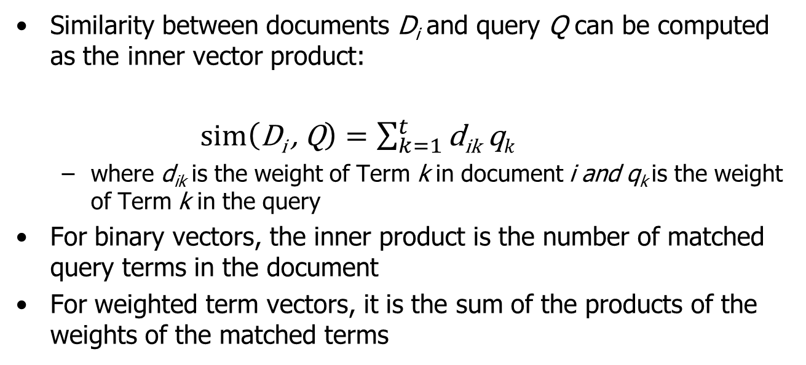
Similarity Measure - Inner Product
000 Dik Lun LEE Department of Computer Science, HKUST Slide <number>

Slide 24
Inner Product -- Examples
architecture
management
computer
information
retrieval
text
database
Binary:
  D = 1, 1, 1, 0, 1, 1, 0
  Q = 1, 0 , 1, 0, 0, 1, 1
  sim(D, Q) = 3
Size of vector = size of vocabulary = 7
0 means corresponding term not found in document or query
Weighted:
D₁ = 2T₁ + 3T₂ + 5T₃ D₂ = 3T₁ + 7T₂ + T₃
Q = 0T₁ + 0T₂ + 2T₃
sim(D₁ , Q) = 2*0 + 3*0 + 5*2 = 10
sim(D₂ , Q) = 3*0 + 7*0 + 1*2 = 2
000 Dik Lun LEE Department of Computer Science, HKUST Slide <number>

Slide 25
Properties of Inner Product
The inner product similarity is unbounded
Favors long documents
  long document ⇒ a large number of unique terms, each of which may occur many times
  measures how many terms matched but not how many terms not matched
000 Dik Lun LEE Department of Computer Science, HKUST Slide <number>

Slide 26
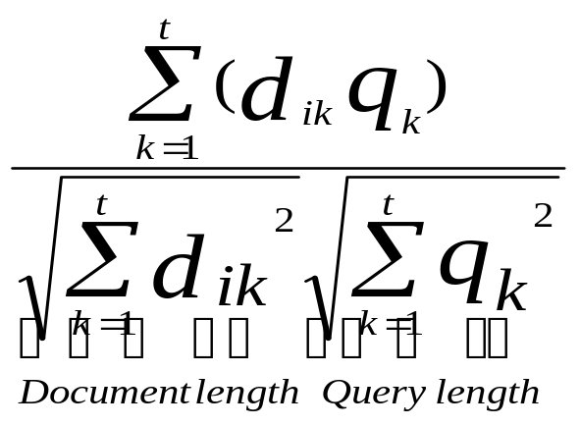
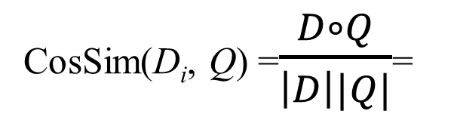
Cosine Similarity Measures
Cosine similarity measures the cosine of the angle between two vectors
Inner product normalized by the vector lengths
t₃
θ₁
D₁
Q
θ₂
t₁
t₂
D₂
D₁ = 2T₁ + 3T₂ + 5T₃
D₂ = 3T₁ + 7T₂ + T₃
Q = 0T₁ + 0T₂ + 2T₃
D₁ is 6 times better than D₂ using cosine similarity but only 5 times better using inner product
CosSim(D₁ , Q) = 5 / √ 38 = 0.81
CosSim(D₂ , Q) = 1 / √ 59 = 0.13
000 Dik Lun LEE Department of Computer Science, HKUST Slide <number>

Slide 27
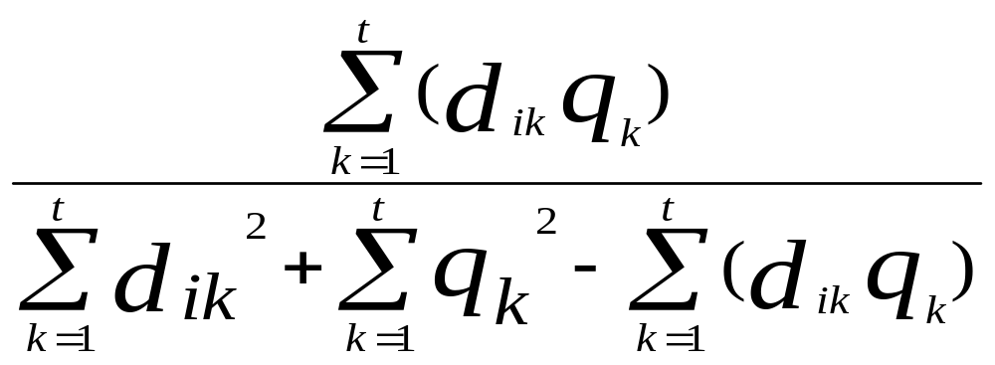
Other Similarity Measures
There are a large number of other similarity measures.
Jaccard Coefficient:
D₁ = 2T₁ + 3T₂ + 5T₃ Sim(D₁ , Q) = 10 / (38+4-10) = 10/32 = 0.31
D₂ = 3T₁ + 7T₂ + T₃ Sim(D₂ , Q) = 2 / (59+4-2) = 2/61 = 0.04
Q = 0T₁ + 0T₂ + 2T₃
D₁ is 9.5 times better than D₂
Difference between Jaccard and CosSim?
000 Dik Lun LEE Department of Computer Science, HKUST Slide <number>
Notes:
Jaccard coefficient separates the scores of relevant and irrelevant documents further apart. You can see that when the inner product in the numerator is large, the denominator is small, making the final scores even higher.

Slide 28
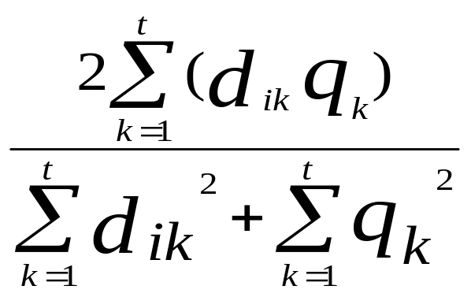
Dice Coefficient
Dice Coefficient:
D₁ = 2T₁ + 3T₂ + 5T₃ Sim(D₁ , Q) = 2*10 / (38+4) = 20/42 = 0.48
D₂ = 3T₁ + 7T₂ + T₃ Sim(D₂ , Q) = 2*2 / (59+4) = 4/63 = 0.06
Q = 0T₁ + 0T₂ + 2T₃
D₁ is 8 times better than D₂
000 Dik Lun LEE Department of Computer Science, HKUST Slide <number>
Notes:
Jaccard coefficient separates the scores of relevant and irrelevant documents further apart. You can see that when the inner product in the numerator is large, the denominator is small, making the final scores even higher.

Slide 29
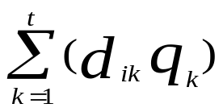
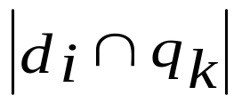
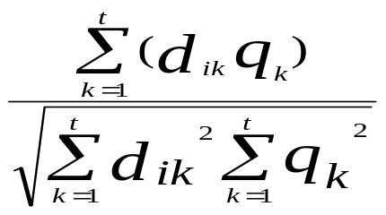
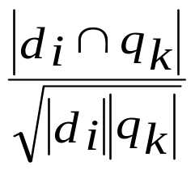
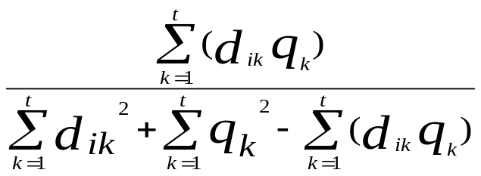
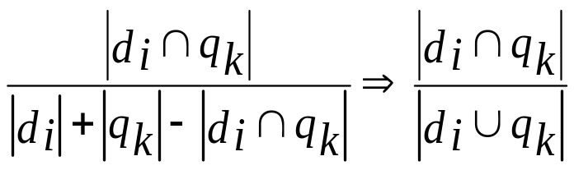
Binary Versions of Similarity Measures
 | Non-binary weights | Binary weights
Inner Product:
Cosine:
Jaccard :
 | d_{i} and q_{k} are vectors | d_{i} and q_{k} are sets of keywords | d_{i} | or | q_{k} |: Number of non-zero elements in the set (Note: since the weights are binary, the square in the non-binary formula can be ignored)
Jaccard with binary weights is the intersection of the query and document divided by their union.
When d_{i}=q_{k}, Jaccard similarity = 1 (highest possible)
When d_{i}⊃q_{k}, Jaccard similarity decreases as |d_{i}| increases (penalized long documents)
000 Dik Lun LEE Department of Computer Science, HKUST Slide <number>
Notes:
Jaccard coefficient separates the scores of relevant and irrelevant documents further apart. You can see that when the inner product in the numerator is large, the denominator is small, making the final scores even higher.

Slide 30
Similarity between a Query and a Document
Query
Document
Term-ID | TF
123 | 5
145 | 2
320 | 3
344 | 1
390 | 1
450 | 1
482 | 1
544 | 1
580 | 1
590 | 3
610 | 1
630 | 1
661 | 1
702 | 2
758 | 1
850 | 1
887 | 1
950 | 2
Given a query containing terms: 123, 345, 544, 642, 850, the corresponding DF’s and the document vector
Assume the collection contains 10,000 documents
Q-ID | DF
123 | 50
345 | 540
544 | 1300
642 | 35
850 | 250
Term-ID | tf() | idf() | tf*idf
123 | 5 | log₂(10000/50) = 7.64 | 38.2
345 | 0 | No need to calculate it! | 0
544 | 1 | log₂(10000/1300) = 2.94 | 2.94
642 | 0 | No need to calculate it! | 0
850 | 1 | log₂(10000/250) = 5.32 | 5.32
Inner(D,Q) = 38.2 + 2.94 + 5.32 = 46.46
How to obtain cosine?
000 Dik Lun LEE Department of Computer Science, HKUST Slide <number>

Slide 31
Document Clusters and Centroids
000 Dik Lun LEE Department of Computer Science, HKUST Slide <number>

Slide 32
Comparing Documents against Documents
Similarity can be computed:
  Between document and query vectors ⇒ search engine (ranking)
  Between document and document vectors ⇒ document clustering
  Between query and query vectors ⇒ query suggestion, query expansion, etc.
D₁ = 1, 1, 1, 0, 1, 1, 0
D₂ = 1, 0 , 1, 0, 0, 1, 1
D₃ = 0.5, 2, 0, 0, 1, 1, 0.5
What are the similarity between these documents?
How close are these documents?
  Total similarity, average similarity (needs n*(n-1)/2 similarity computations)
000 Dik Lun LEE Department of Computer Science, HKUST Slide <number>
Notes:
Jaccard coefficient separates the scores of relevant and irrelevant documents further apart. You can see that when the inner product in the numerator is large, the denominator is small, making the final scores even higher.

Slide 33
Document Centroid
Given a set of m document vectors :
c_{k}: average over m documents
d1
d1=[ T_{1,1} … T_{1,k} … … T_{1,t} ]
d2=[ T_{2,1} … T_{2,k} … … T_{2,t} ]
d3=[ T_{3,1} … T_{3,k} … … T_{3,t} ]
d4=[ T_{4,1} … T_{4,k} … … T_{4,t} ]
d3
d2
d4
The centroid of the m document vectors is a “virtual” document vector C:
  C = (c₁, c₂, …, c_{k} …, c_{t}) where c_{k} = ( ∑_{i=1}^{m} T_{i,k)}) /m
  Centroid is a convenient and compact representation of a set of documents
  The closeness of a document set can be measured by the distances of the documents to their centroid

Slide 34
Geometric Interpretation of Similarity Measures
Cosine similarity: we all know by now that it is the angle between two vectors (query and document vectors)
Inner product:
What about Euclidian distance?
000 Dik Lun LEE Department of Computer Science, HKUST Slide <number>
Notes:
Jaccard coefficient separates the scores of relevant and irrelevant documents further apart. You can see that when the inner product in the numerator is large, the denominator is small, making the final scores even higher.

Slide 35
Choice of Similarity Measures
The vector space model can match queries against documents, or documents against documents, but the interpretations and match criteria are different
architecture
management
computer
information
retrieval
text
database
D = 1, 1, 1, 0, 1, 1, 0
Q = 1, 0 , 1, 0, 0, 1, 1
Q wants “retrieval”, “architecture”, “information” and “management”. It doesn’t care about other things.
D meets three out of the four “wants”; match well
D₁ = 1, 1, 1, 0, 1, 1, 0
D₂ = 1, 0 , 1, 0, 0, 1, 1
D₁ talks about “database”, “retrieval”, “architecture”, “text”, and “management” but not about “information”.
D₂ talks about “retrieval”, “architecture”, “information”, and “management” but not about “database” and “text”.
Are D₁ and D₂ very similar? Three matches, three mismatches, and one common absence (i.e., computer).
000 Dik Lun LEE Department of Computer Science, HKUST Slide <number>
Notes:
Jaccard coefficient separates the scores of relevant and irrelevant documents further apart. You can see that when the inner product in the numerator is large, the denominator is small, making the final scores even higher.

Slide 36
Similarity Measures for Documents Comparison
 | Document / Document | Document / Query
Euclidean | OK | Bad
Cosine | OK | OK
Inner | Fair | OK
Jaccard | Fair+ | OK
000 Dik Lun LEE Department of Computer Science, HKUST Slide <number>
Notes:
Jaccard coefficient separates the scores of relevant and irrelevant documents further apart. You can see that when the inner product in the numerator is large, the denominator is small, making the final scores even higher.

Slide 37
Some Issues about Similarity Measures
000 Dik Lun LEE Department of Computer Science, HKUST Slide <number>

Slide 38
Query Term Weights
The weight of a query term is assumed to be 1 if the term presents in the query; 0 otherwise
A weight may be given by the user to each query term
A natural language query can be regarded as a document
  The query “MP3 songs sung by Aaron Kwok” may be transformed into:
  <MP3, song, sung, Aaron, Kwok>
  The query “I am interested in gold medals or gold investment” may be transformed into:
  <gold 2, medal 1, investment 1> after filtering out “I am interested in”
Similarity of two documents can be computed in the same way
000 Dik Lun LEE Department of Computer Science, HKUST Slide <number>

Slide 39
Information Abundance on Web
Question: Is the vector space model more like ‘OR’ or ‘AND’?
Given the answer to the above question, do you think the vector space model is good or bad in
  A professional database (e.g., legal or medical datasets)?
  web retrieval?
Just type in as many relevant words as you can think of, you will find something useful from the web (Google), especially for popular topics (e.g., presidential election), since there are many sources of information on popular topics.
000 Dik Lun LEE Department of Computer Science, HKUST Slide <number>

Slide 40
Term Independence Assumption (I)
Each term i is identified as T_{i}
A document is represented as a set of unordered terms, called the bag-of-words (bow) representation
The terms are assumed to be independent (or uncorrelated or orthogonal) to each other and form an orthogonal vector space
On the left: x and y are orthogonal; y = x cos 90° = 0 * x
On the right: x and y are not orthogonal; y = x cos θ
What does it mean to retrieval?
  D1 = < computer, CPU, Intel >
  D2 = < computer, analysis, price >
  Q = < computer >
  Intuitively, is D1 or D2 a better match? What does vector space model tell you?
  Should D1 be represented as < computer 2.5 > ?
How to measure term dependence and incorporate it into retrieval?
y
y
θ
x
x
000 Dik Lun LEE Department of Computer Science, HKUST Slide <number>

Slide 41
Term Independence Assumption (II)
In real life, it is hard to find two terms that are absolutely independent to each other
Independence can be judged with respect to a document collection.
“computer” “science” “business”
CS collection
Important words in the collection
In reality, these three terms are correlated to each other!
  When you can find “computer” in a document, there is a very high chance that you also find “science” in it
  When you can find “computer” in a document, there is a medium chance that you also find “business” in it
  When you can find “business” in a document, there is a small chance that you also find “science” in it
We can judge term independence by checking whether or not two terms frequently co-occur in a document (or a sentence, a window of text, etc.)
000 Dik Lun LEE Department of Computer Science, HKUST Slide <number>

Slide 42
Synonyms
Two terms have the same meaning (synonyms), more or less
  D1 = < company, earning, invest >
  Q = < corporation, earning >
  Straight keyword matching will cause a mismatch between company and corporation
  D1 = < furniture, table, desk, chair, lamp >
  Q = < furniture >
  Straight keyword matching will have only one matching keyword and so D1 has a small similarity to Q
000 Dik Lun LEE Department of Computer Science, HKUST Slide <number>

Slide 43
Unbalanced Property of Vector Space Model
If Q = ⟨x, y⟩, then
  D₂ contains ⟨x, x⟩ (talk only about x but a lot of it) and D₁ contains ⟨x, y⟩ (talk about both x and y) will have the same similarity to Q
Example 2: Cosine
Example 1: Inner product
y
x y
D₂ = ⟨ 2, 0 ⟩
D₁ = ⟨ 1, 1 ⟩
Q = ⟨ 1, 1 ⟩
D₁
Q
D₂
x
000 Dik Lun LEE Department of Computer Science, HKUST Slide <number>
Notes:
Jaccard coefficient separates the scores of relevant and irrelevant documents further apart. You can see that when the inner product in the numerator is large, the denominator is small, making the final scores even higher.

Slide 44
What Problems does it Cause?
What are the impacts of the unbalanced property on the following queries?
  Hong Kong University
  Travel moon
000 Dik Lun LEE Department of Computer Science, HKUST Slide <number>

Slide 45
How to Favor “Balanced” Documents?
Multi-step filtering
  Filter out all documents containing both x and y, rank them higher
  Filter out all documents containing either x or y, rank them lower
Compute similarity as usual but weight the similarity by the number of query terms matched
  Sim’(D, Q) = Sim(D, Q) * [ | D ∩ Q | / | D ∪ Q | ]
000 Dik Lun LEE Department of Computer Science, HKUST Slide <number>
Notes:
Jaccard coefficient separates the scores of relevant and irrelevant documents further apart. You can see that when the inner product in the numerator is large, the denominator is small, making the final scores even higher.

Slide 46
Ranking with Boolean Operators
Boolean Models − Strengths
Statistical model is more like the “OR” operator
Boolean and vector space models can be combined by doing Boolean filtering first followed by ranking:
  First evaluate the Boolean query as usual
  collect all documents satisfying the Boolean query
  Rank the result using the vector space query
documents
Boolean
query
Boolean filter
ranking
Vector-space
query
results
Altavista Advanced Search: Boolean query and ranking criteria are separated
  Query: gold AND investment
  Ranking Criteria: precious metal
In most other systems, the vector space query is the same as the Boolean query with Boolean operators ignored
000 Dik Lun LEE Department of Computer Science, HKUST Slide <number>

Slide 47
Summary
Cosine similarity is independent of document sizes
Based on occurrence frequencies only
Consider both local and global occurrence frequencies
Advantages
  simplicity
  able to handle weighted terms
  easy to modify term vectors
Disadvantages
  assumption of term independence
  lack the control of Boolean model (e.g., requiring a term to appear in a document); e.g., two documents D_{i} = ⟨x, x⟩ and D_{j} = ⟨x, y⟩ may yield the same similarity score for Q = ⟨x, y⟩ if x and y have the same weight; this may not be desirable.
000 Dik Lun LEE Department of Computer Science, HKUST Slide <number>

